Slide 1


Sales & financial analysis
AtliQ
Hardware

Slide 2




Microsoft Excel Project
CodeBasics Data Analytics Bootcamp
Presented by
Jyot Kikani

Slide 3
From Margins to Millions: AtliQ’s Sales Journey

Slide 4
agenda
About the Company
Problem Statement
Project Goals
Data Sources and Data Modeling
Dashboard Overview
Recommendations

Slide 5

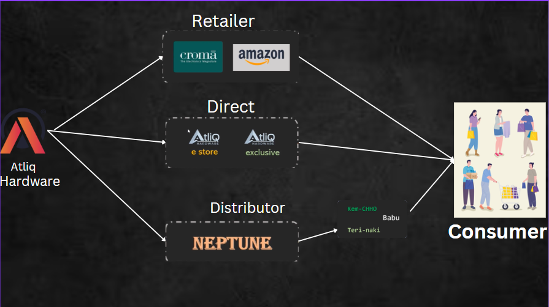
ABOUNT THE COMPANY
AtliQ Hardware is a fast-growing global brand known for its diverse range of hardware products like PC, Mouse, Keyboards, Printers through different stores like Croma , Best Buy and Staples & Online platform like Amazon and Flipkart. Three main channels are Retailers, Direct Sales and distributors across regions spanning Asia pacific, Latin America, North America and Europe.

Slide 6

Challenge Overview
AtliQ Hardware is facing significant losses in the recent years.
Rely on Hand-written reports and surveys.
Need for Insightful Decision-making strategies.
Need to analyze the Sales and Financial reports over the years to make the actionable steps.

Slide 7
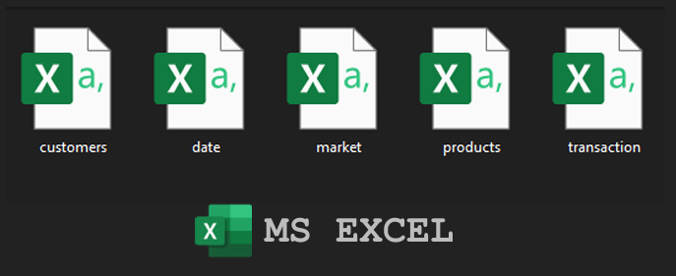
Data Foundations & Tools

Slide 8
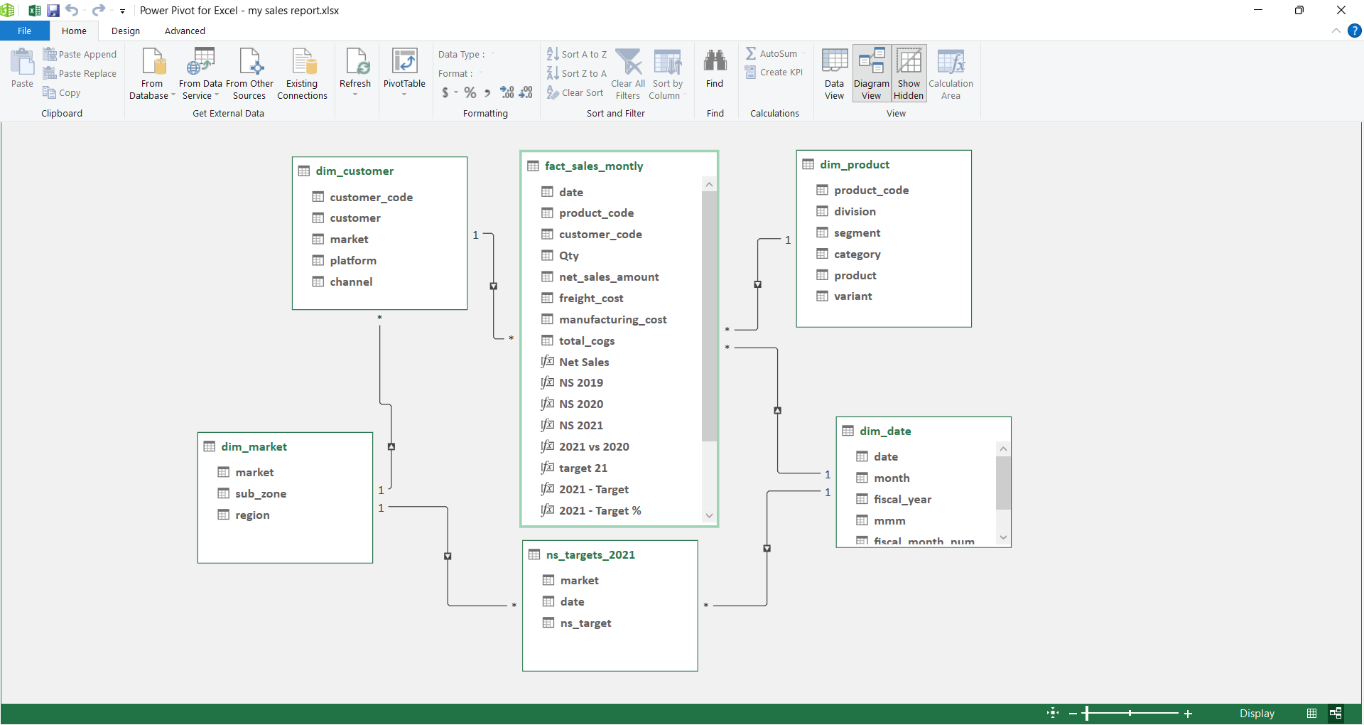
DATA MODELING

Slide 9
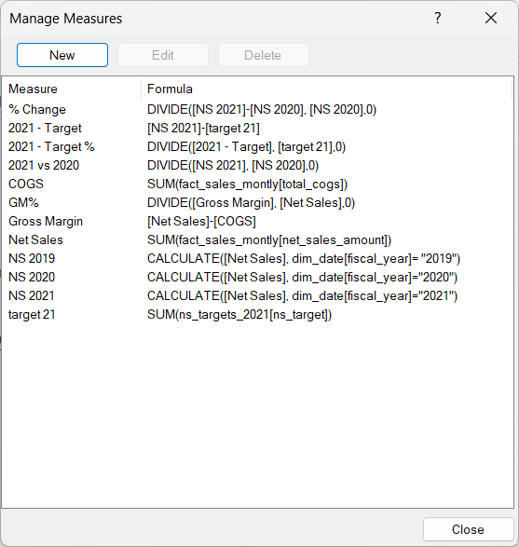
DAX MEASURES

Slide 10

REPORTS
SALES
FINANCE
Customer Performance Report
Market Performance Report
Top 10 Products by Net Sales
Division Report
Top a& Bottom 5 products by Quantity
New Products of 2021
Top 5 Countries by Net Sales
P&L by Fiscal Year
P&L by Fiscal Months
P&L by Market
GM% Quarterly

Slide 11

Sales reports

Slide 12
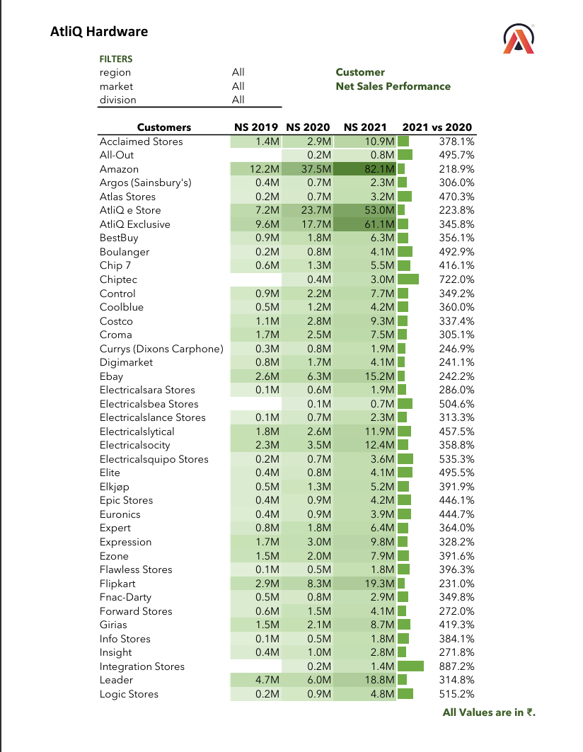
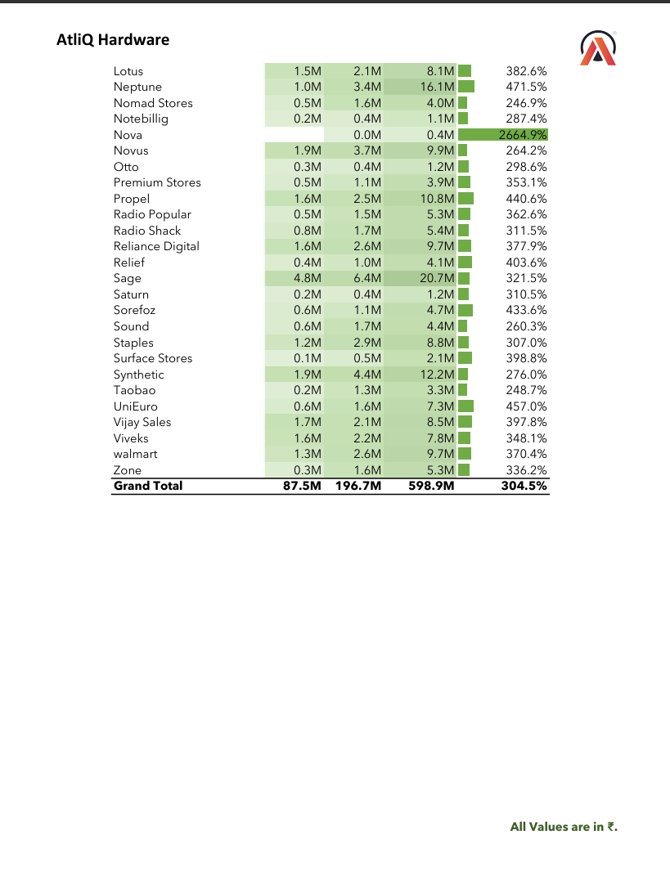
Customer performance report

Slide 13
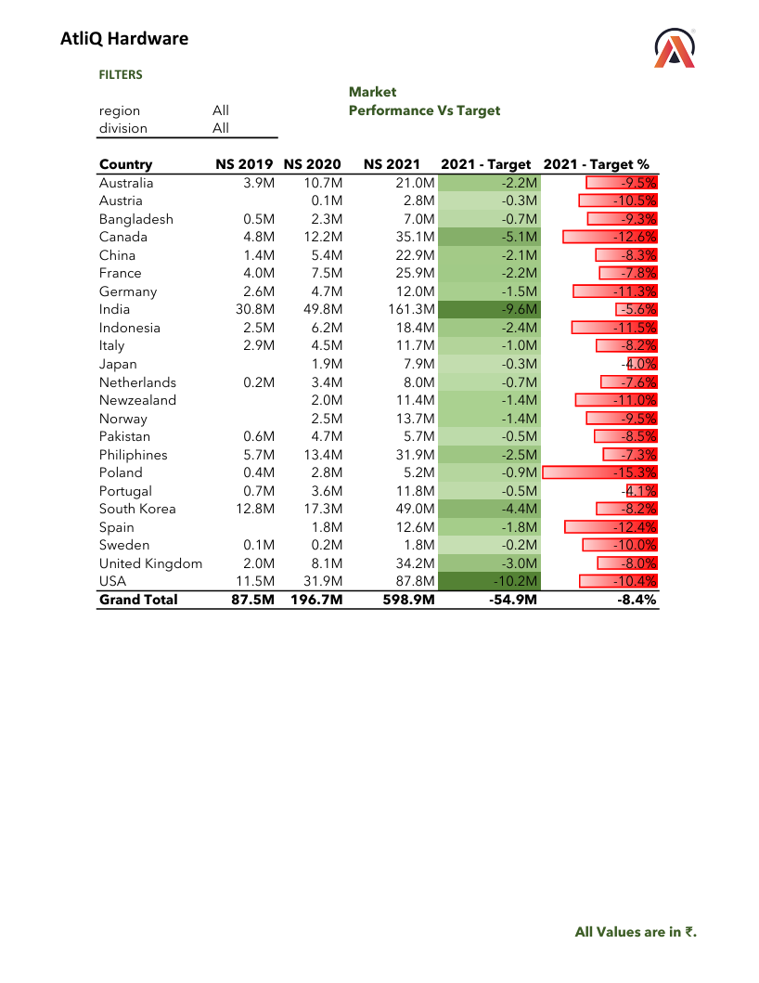
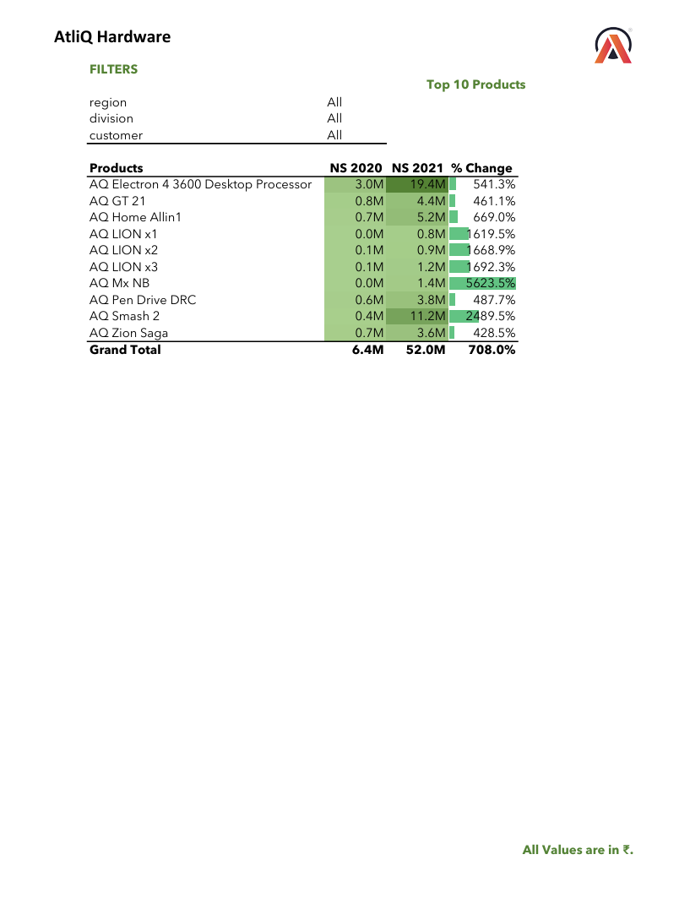
market performance report & Top 10 Products by Net Sales

Slide 14
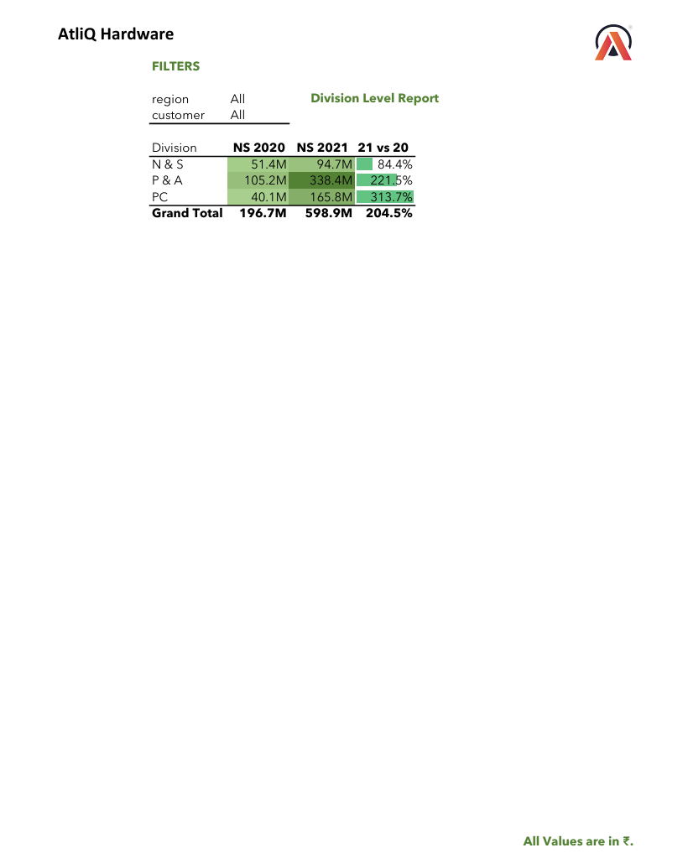
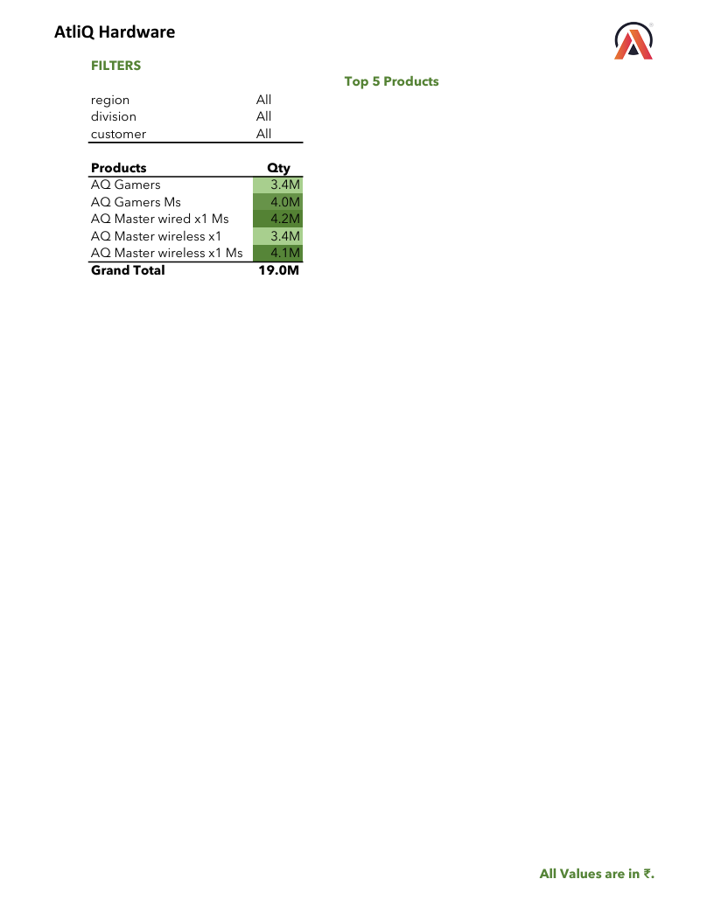
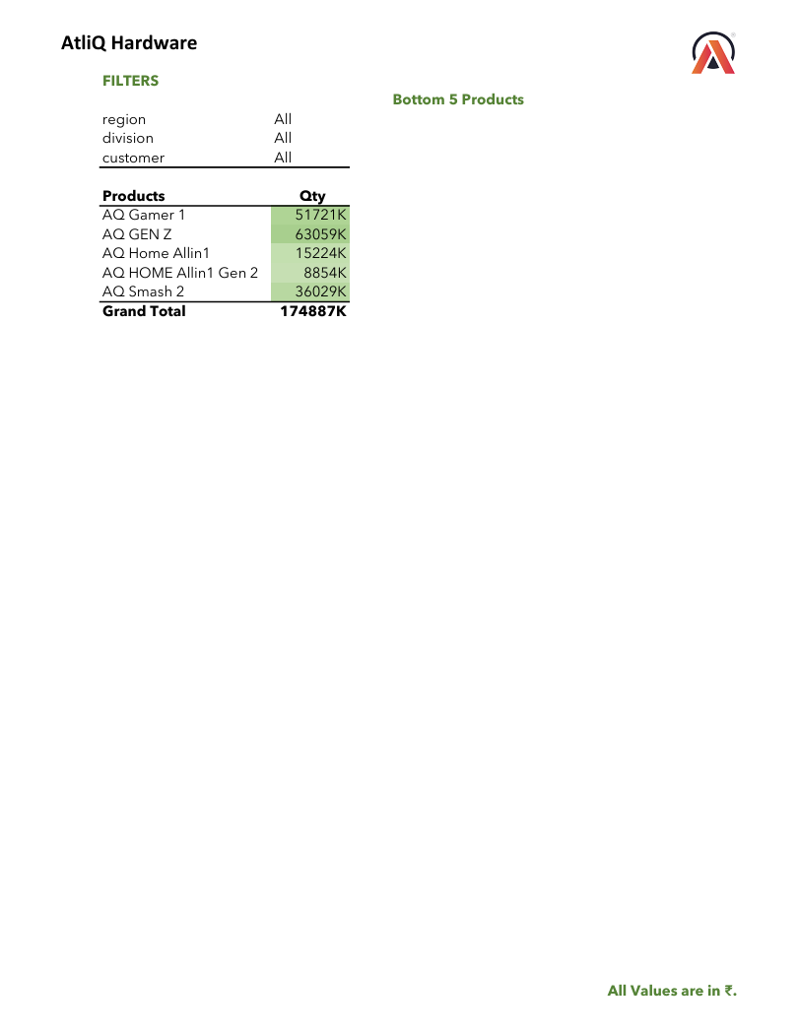
Divisional report and top - bottom 5 products by qty report

Slide 15
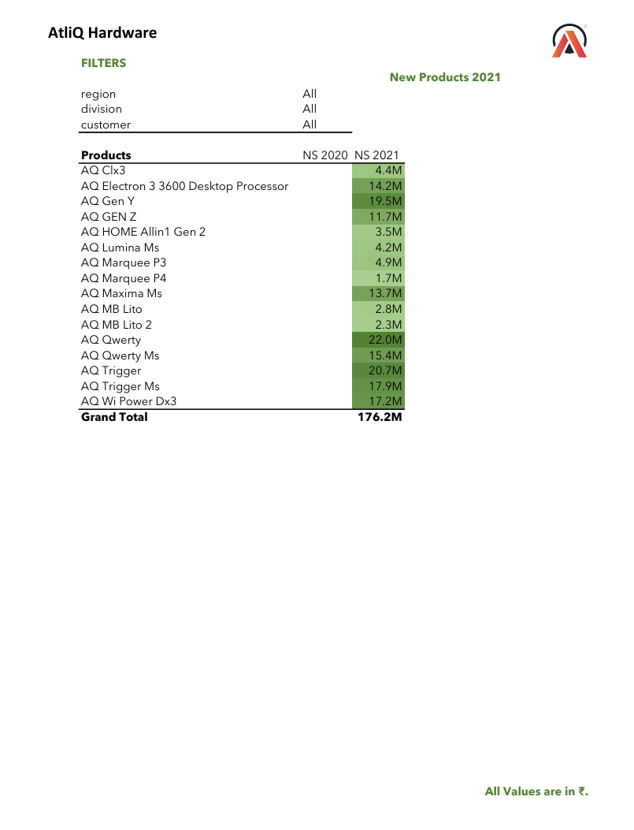
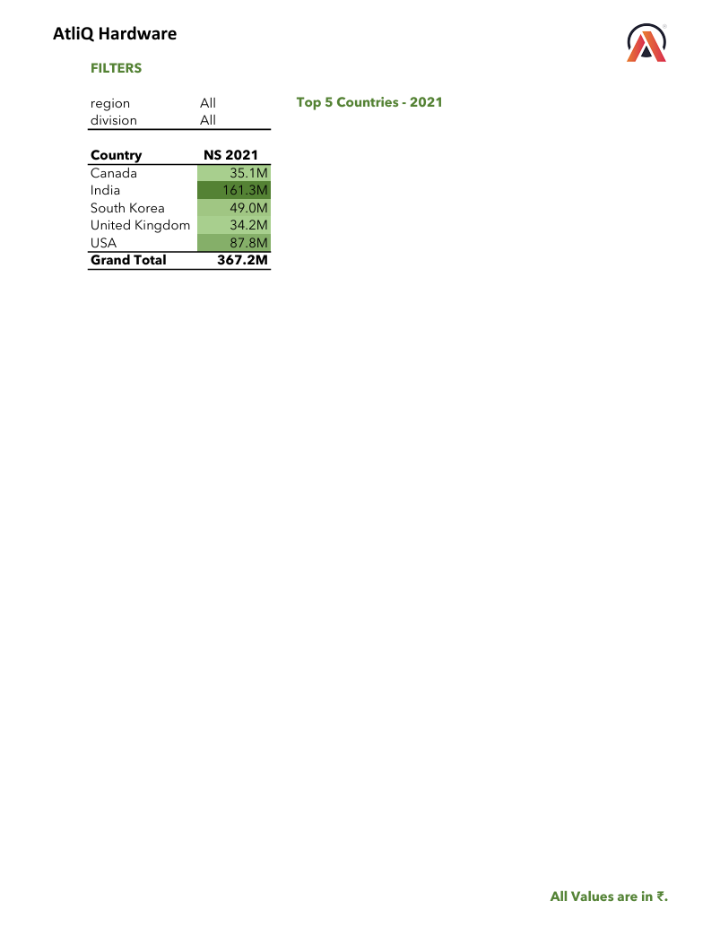
New Products 2021 & Top 5 countries by net sales

Slide 16

P & l reports

Slide 17
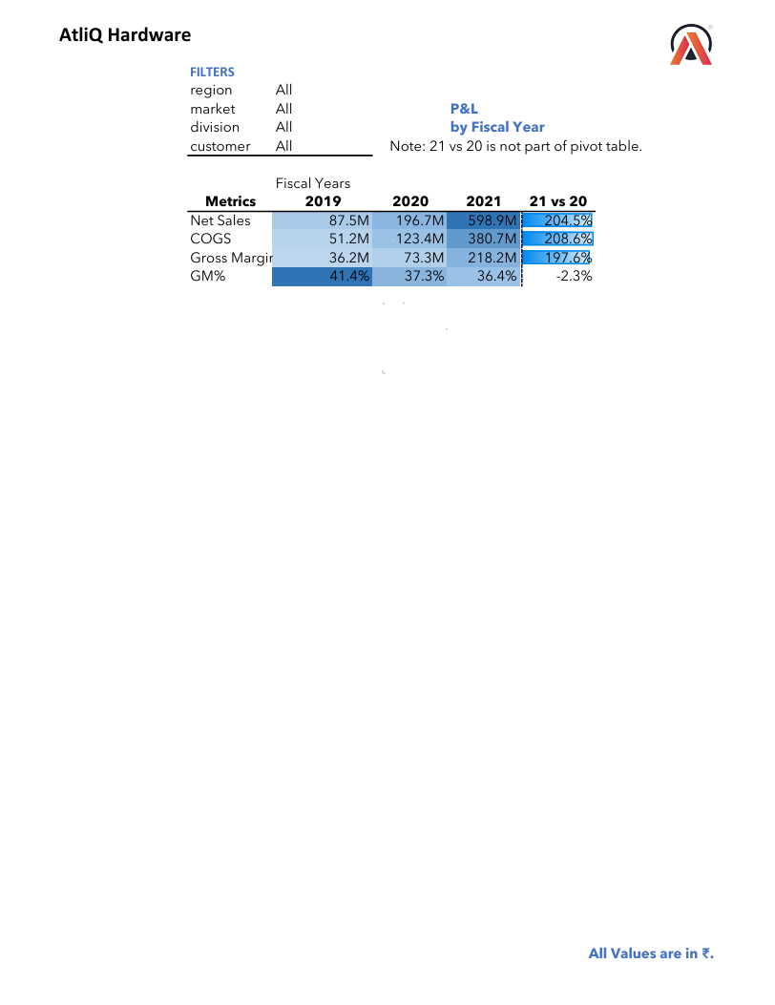
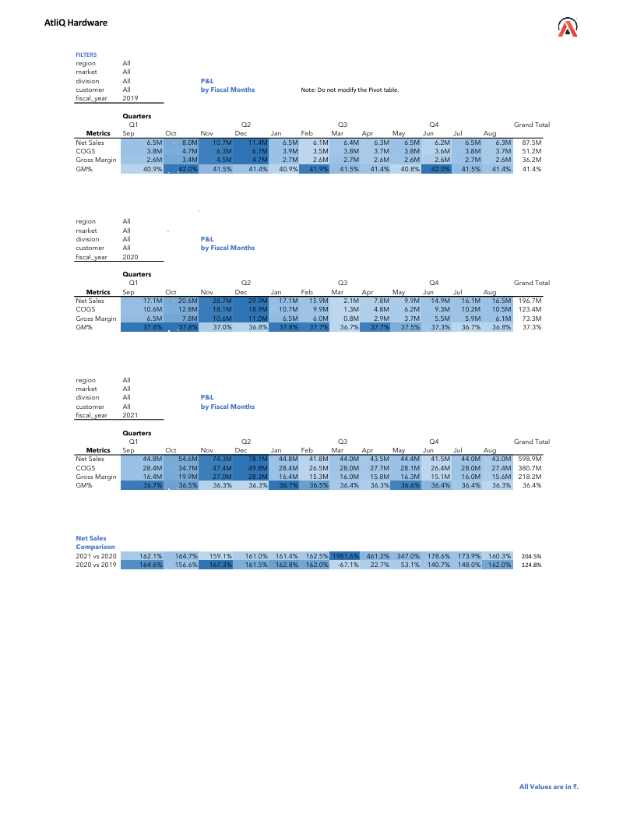
P & l by fiscal year & Month

Slide 18
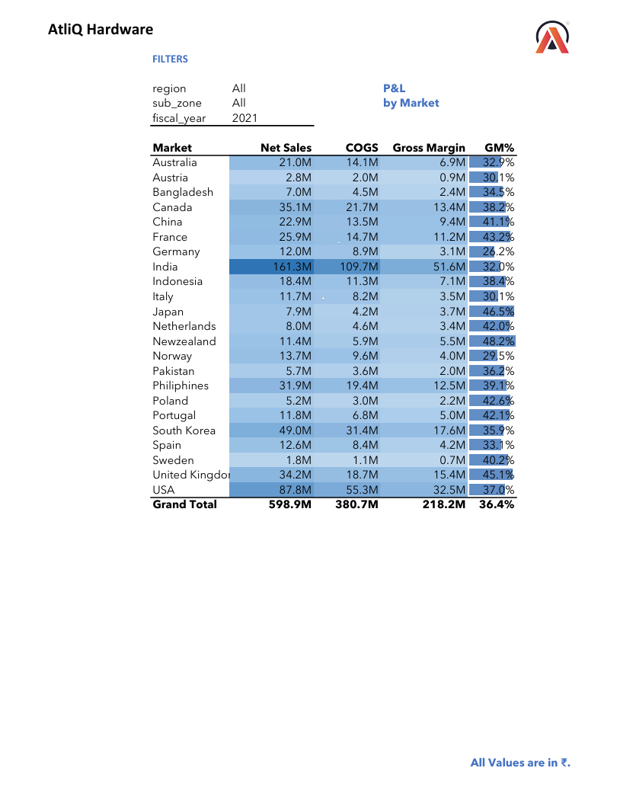
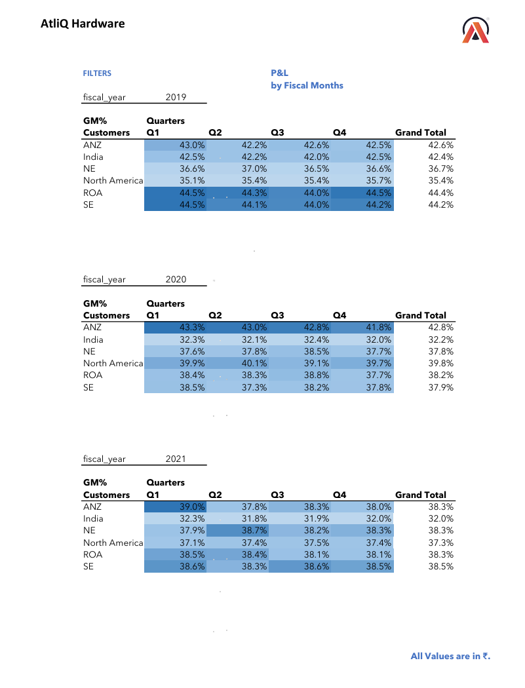
P & l by market and gm% quarterly

Slide 19



Thank You for Lighting the Way
Dhaval Patel
CodeBasics Content team
Hemanand Vadivel

Slide 20

Signing Off with Thanks

Slide 21
Thank you
Brita Tamm
502-555-0152
brita@firstupconsultants.com
www.firstupconsultants.com

